Slide 1
Site Suitability Subgroup Update
September 17, 2021

Slide 2
Exciting Updates from the Guidance Group
New branding!
CFARS website now live (albeit; WIP)
https://cfars.github.io/
Join and follow our group on LinkedIn!
https://www.linkedin.com/company/cfars-wind/
20/09/2021

Slide 3
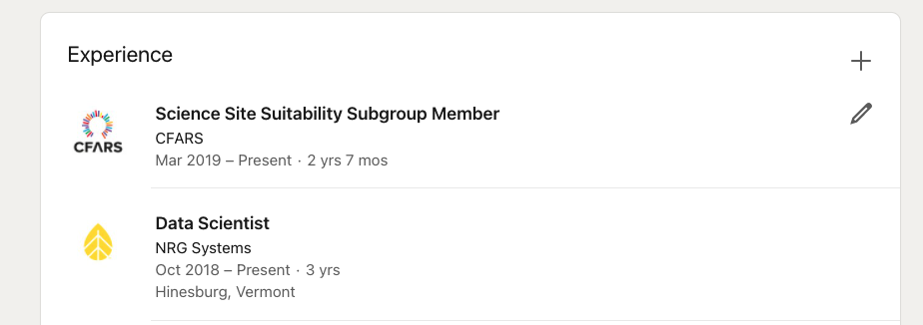
Linked in Connecting
20/09/2021

Slide 4

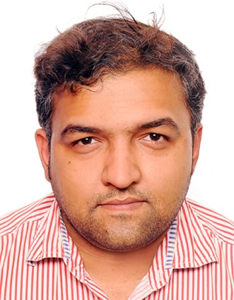

Welcome new industry collaborators to the subgroup!
Sayantan Chattopadhyay
Lise Lotte Bendixen
20/09/2021

Slide 5
Agenda
New RSD TI Adjustment Method [20mins]
Upcoming TACT Subgroup Analysis [10mins]
2021-2023 Proposed Roadmap [10mins]
Subgroup White Paper #1 Update [5mins]
Upcoming ACP Pre – Conference CFARS Session [5 mins]
Discussion/Q&A [10mins]

Slide 6
New RSD TI Adjustment Method – Bandpass Adjusted Turbulence
20/09/2021

Slide 7
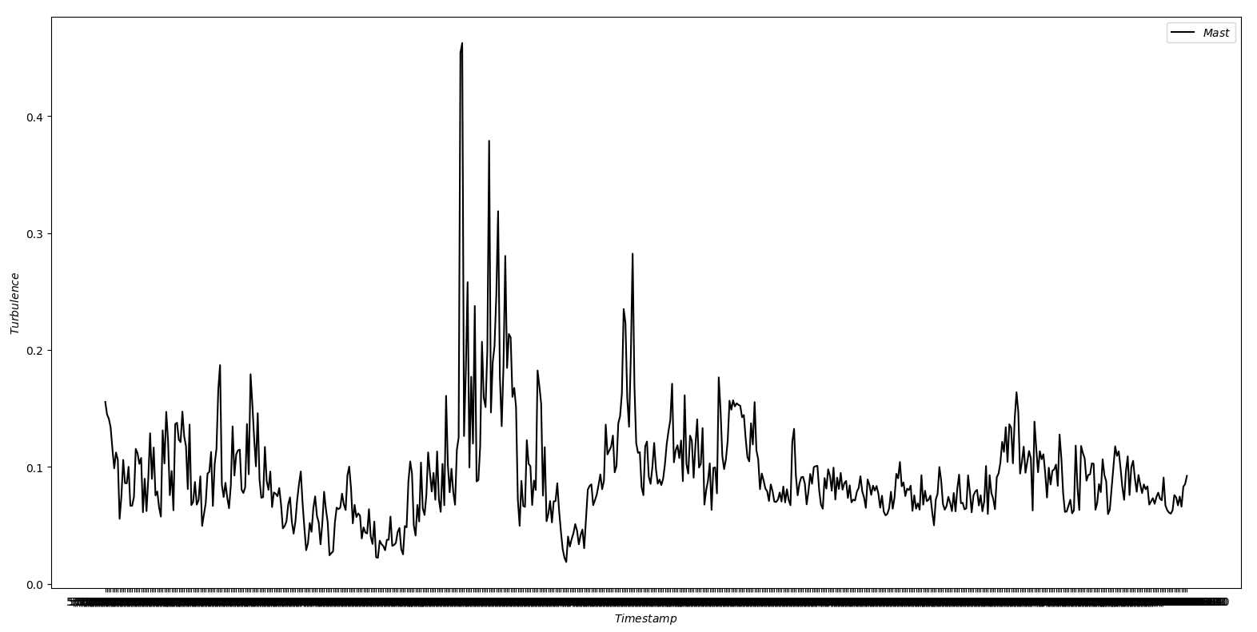
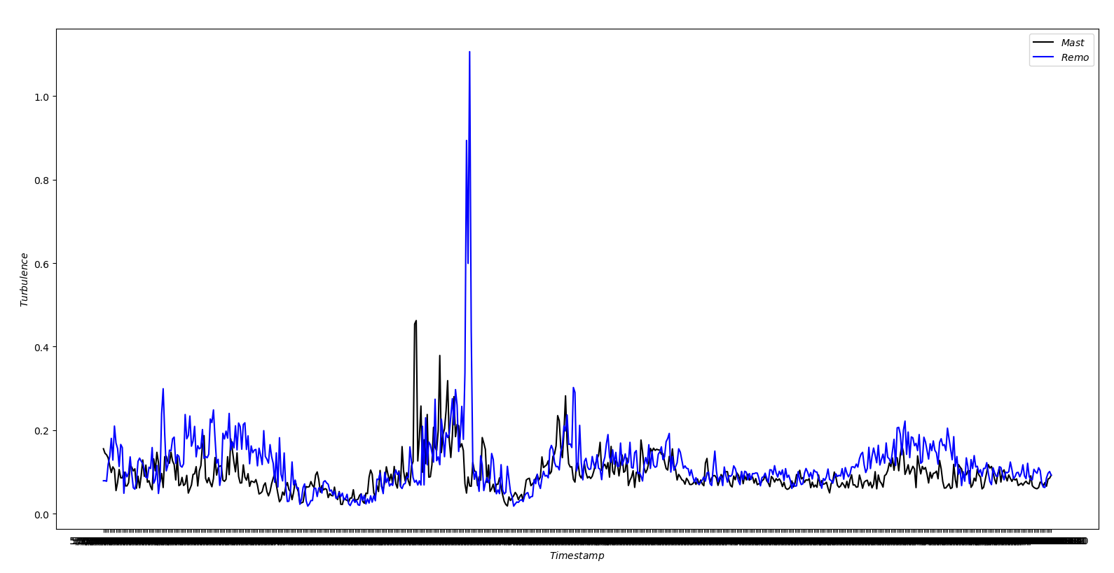
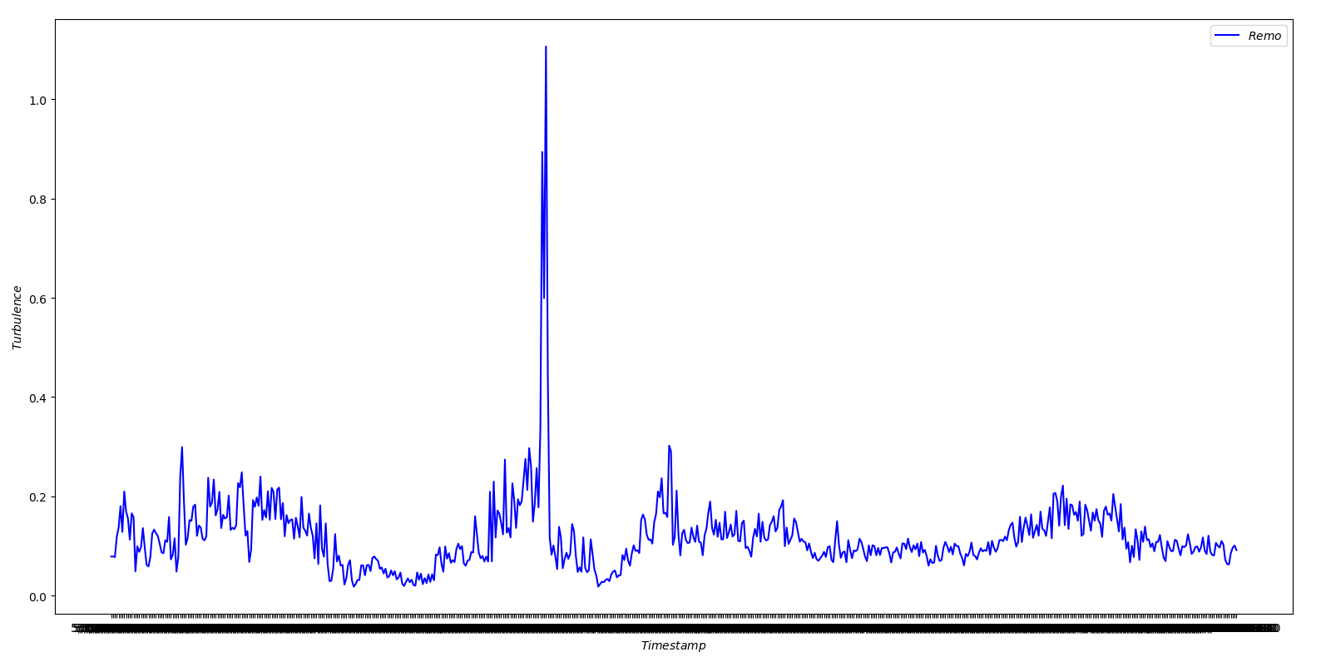
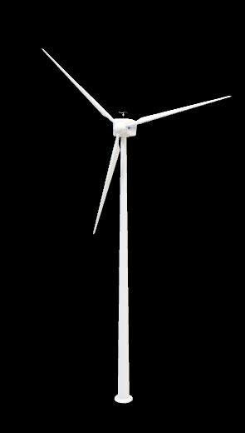
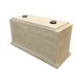
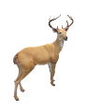
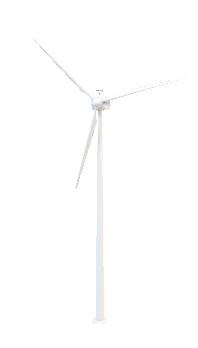

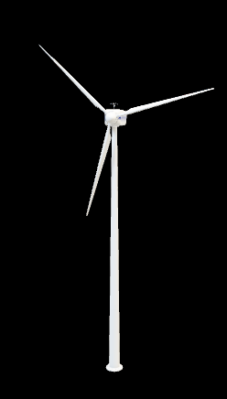
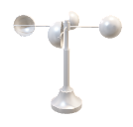
Problem definition: What exactly is the problem? Recap and Introduction

Slide 8


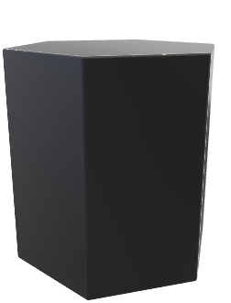
Methodology Mast Equivalent
Transformation of the RSD data to mimic a measurement of a virtual met mast – Mast Equivalent RSD data transform
Of course we take help from other sites which has collocated RSD and Met mast, maybe nearby or maybe in similar site conditions.
This model is called
Transformation Model
Specific to site conditions.
This model is stored
The idea behind the project is not to transform the RSD data to a “correct turbulence” but trying to achieve the correct load response
Algorithm

Slide 9
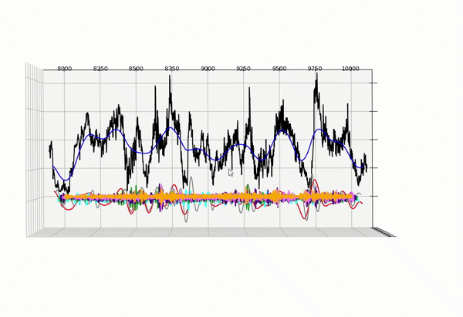
Methodology Algorithm
Selection of the Lag (window)
Decomposition and Reconstruction of each component
The components are additive
Higher components tend to noise

Slide 10
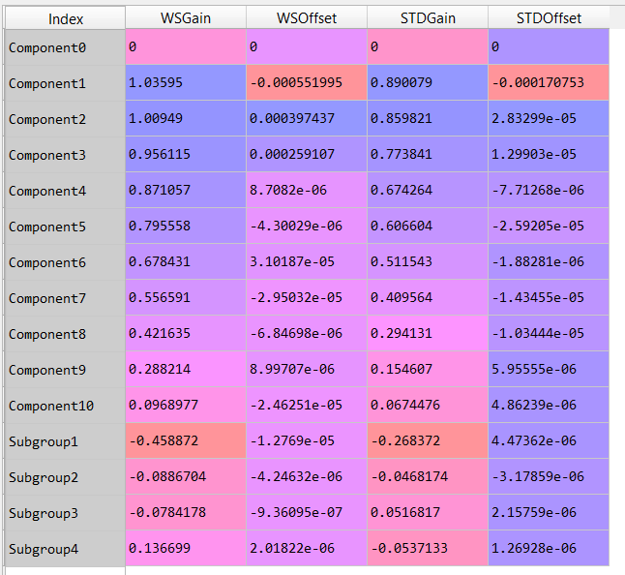
Methodology Algorithm
Comparison and Scaling
Compare each component of RSD and collocated met mast – concurrent data set – similar orographic conditions
Grouping of higher components
Storing the gain & offset
Mast
VS
RSD

Slide 11
Validation LIDAR in Norway
Relative fatigue load response from turbulence driven components
Terrain Description:
Complex terrain
Comment:
The process works quite well in cross predicting in an area, irrespective of complexities surrounding it
Relative Fatigue Loads
Different Fatigue load driven components

Slide 12
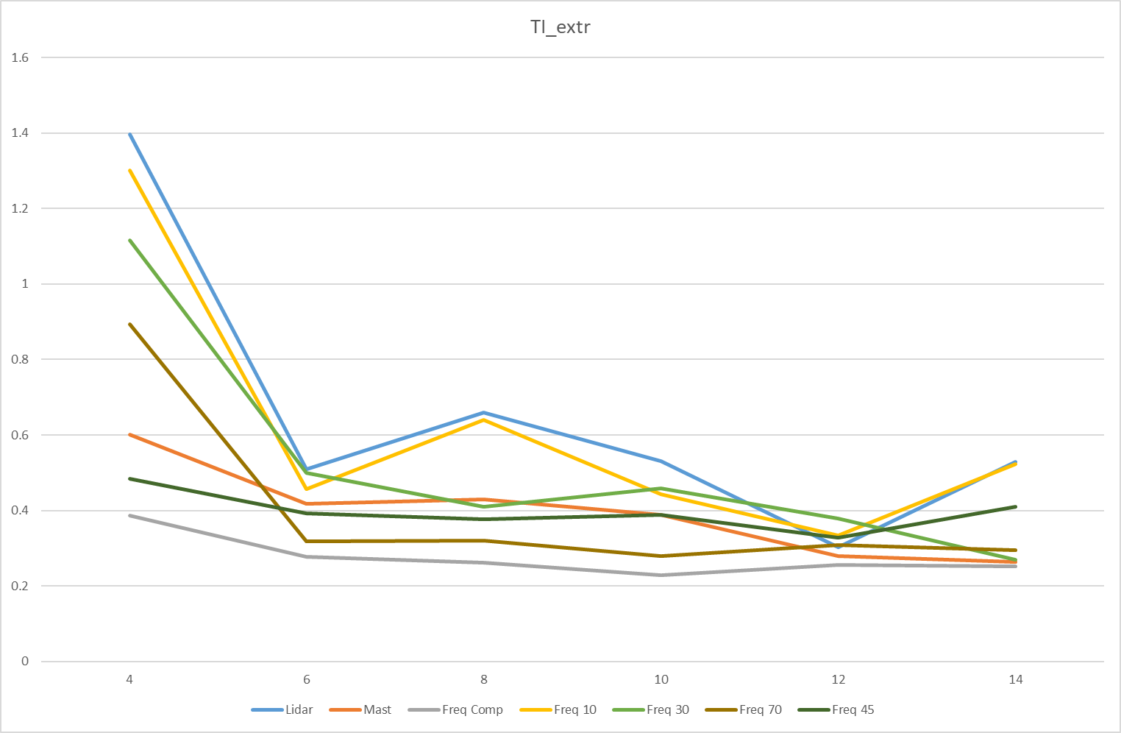
Some more validations More ongoing
Extrapolated Representative TI
Wind Speed (m/s)

Slide 13
Transformation criteria Geographical Classification
Offshore | GC000
Flat,No Forestry,Nearshore | GC001
Flat,No Forestry,Inland | GC002
Flat,Forestry,Nearshore | GC011
Flat,Forestry,Inland | GC012
Semi Complex,No Forestry,Nearshore | GC101
Semi Complex, No Forestry,Inland | GC102
Semi Complex,Forestry,Nearshore | GC111
Semi Complex,Forestry,Inland | GC112
Complex,No Forestry,Nearshore | GC201
Complex,No Forestry,Inland | GC202
Complex,Forestry,Nearshore | GC211
Complex,Forestry,Inland | GC212
Points to be filled
Inflow angle
% forest cover in 5kms range
distance between met mast and forest
avg height of trees
% water bodies in 5kms range

Slide 14
A New Ask…Creation of RSD R&D dataset → CARE CFARS anonymous repository
WHY?
Enable CFARS participants to benchmark, develop and optimize any ‘new’ RSD TI method as the science evolves
Optimize existing RSD TI adjustment methods in TACT (i.e., machine learning)
Eliminates piece-meal / isolated benchmarking of RSD TI adjustment method performance due to lack of industry database.. move the industry forward faster!
Overcome barriers for participants running TACT, and TACT development

Slide 15
The New Ask…Creation of R&D dataset → CARE CFARS anonymous repository
How?
CFARS subgroup participants share project data to NREL, following old and new data requirement guidelines; NREL will compile CARE and run TACT with it. NREL will also co-lead analysis for technical peer reviewed article
Rather than participants running TACT themselves and sending results

Slide 16
What’s Needed to Optimize This Method?
What?
Requirements:
Collocated mast and RSD
~ <500m and disclose distance and relative position between them
RSD make and model (not abs required)
Cup make and model
Inflow angle
> 6 months time period , around 80% availability
Choose one of the 13 terrain categories
complex (semi/complex/flat)
forested (yes/no), % forest cover in 5km range, avg height of trees
inland and near shore, % water bodies in 5km range
offshore
Data cleaning
best practice within each organization OK
Data channels
10 mins timestamps and/or 1 hz
mean WS, SD, direction
20/09/2021

Slide 17
Upcoming Subgroup TACT Analysis - TI Adjustment Comparison Tool
20/09/2021

Slide 18
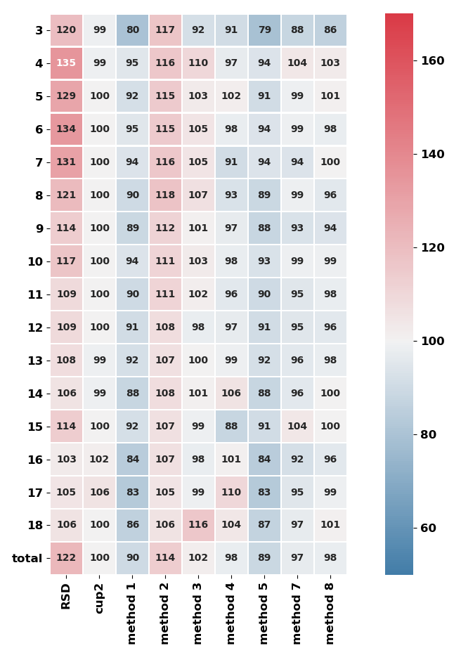




Overview of Revised CFARS TACT Analysis
Turbine Load
Sensitivity Analysis
from Various TI Input
CFARS Anonymous Repository (CARE)
(using Task 43 data model guidance)
Subgroup aggregated
results
passed to
EMD, NREL, and turbine OEMs
TACT.py
TACT Results
Blades Component Loads Model
Output from Various TI Input
Standardized IEC -15 output for
site suitability
Example Output
Wind Speed
Percent of Reference Cup Load
Comparison Metrics
WS binned relative MBE & RMSE error statistics
Results from sensitivity &c statistical tests (e.g., length of dataset, TKE, TI distribution like-ness by bin)
10-minute adjusted RSD & representative TI measurements
https://github.com/CFARS/site_suitability_tool

Slide 19
Key Opensource TACT Revisions
Strengthening partnership with NREL:
Method verification & TACT code review
Updated user/contributor agreement
Restructure for easier user interaction / transparency
Easier user interface / ‘runability’
20/09/2021

Slide 20
2021-2023 Proposed Roadmap
20/09/2021

Slide 21
2021-2022 Proposed Roadmap
Step 1: Generic BAT RSD TI adjustment method incorporated into TACT [Nov 2021]
Step 2: Subgroup participants send project data to NREL for compilation of CFARS anonymous repository (CARE) (CARE is accessible to industry) [Nov 2021]
Sept3a: CFARS optimizes and validates the BAT RSD TI adjustment method’s impact on generic loads model output [Feb 2022]
Step3b: Turbine OEMs optimize and validate the generic low pass filter RSD TI adjustment method’s impact on proprietary loads model output [Feb 2022]
Step 4: BAT validation results sharing session [Mar 2022]
Step 5: Incorporation of optimized BAT method into TACT [Apr 2022]
20/09/2021

Slide 22
2021-2022 Proposed Roadmap
Step 6: Subgroup TACT benchmarking exercise kicked off using CARE [Apr 2022]
Step 7: First results from subgroup TACT analysis presented [Jun 2022]
Step 8: Presentation of subgroup TACT benchmarking results at ACP wind resource conference [Sept 2022]
Step 9: CFARS technical publication submission on benchmarking results [Spring 2023]
20/09/2021

Slide 23
Subgroup White Paper Update
20/09/2021

Slide 24
Subgroup White Paper # 1 Release
To be released September 27th (!) on Zenodo
https://zenodo.org/communities/cfars/about/
Reviewed by industry thought-leaders and endorsements:
IEA Task 32
UL
Natural Power
WSP
NREL
DNV
Welcome your final read through and feedback by EOB Thursday, September 23rd
20/09/2021

Slide 25
Upcoming ACP CFARS Pre-Conference Session
20/09/2021

Slide 26
CFARS - An Open Source Industry Approach to Accelerate the Acceptance of Remote Sensing in Wind Energy Assessment
Please join us at the ACP Resource & Project Energy Assessment Virtual Summit
https://cleanpower.org/events/resource-project-energy-assessment-virtual-summit-2021/
Date/Time: Monday, September 27th, 12:00-1:30PM Central USA
Session Details:
Moderator: Neil Adams, Manager Offshore Wind, The Carbon Trust
Updates from each CFARS subgroup
20/09/2021

Slide 27
Key Take Aways
20/09/2021

Slide 28
Summary & Next Steps
Exciting new collaborations with Vestas announced and strengthening collaboration with NREL
Prior to running the TACT benchmarking exercise, one promising RSD TI adjustment method will be optimized and included in TACT
Call for subgroup participants to gather datasets for CARE and TACT benchmarking exercise
White paper #1 summarizing subgroup’s past analyses to be released imminently – final feedback welcomed!

Slide 29
Discussion / Q&A
20/09/2021

Slide 30
Back-Up
20/09/2021

Slide 31
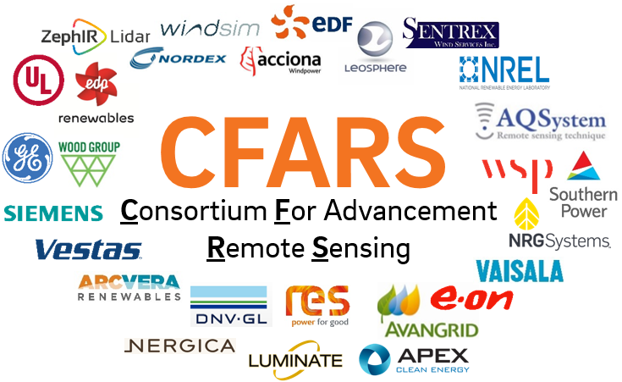
Running Phase 3a Tool
Optimal
Benefit that L-TERRA’s machine learning model can train and build model on entire CFARS group datasets, thus likely lead to a more accurate global (no collocated met mast) lidar TI correction model
Participants prepare datasets (phase 3 data request criteria)
See example Phase 3 output file
Participants sends zipped data file to NREL
(TBD on details)
NREL run phase 3 tool
(Python opensource)
NREL shares result output statistics with CFARS SS subgroup
- NDA required with NREL for Global L-TERRA on all data
- NDA required with IFPEN for Windcube WISE Method results
Notes:
Need to convert .zph file to .csv to be able to read (need ZX exec to convert it)
Scott to send example zx file 10min file

Slide 32
Running Phase 3b Tool
Nice-to-have
See example Phase 3 output file
Participants prepare datasets (phase 3 data request criteria)
Participants run
phase 3 tool
(Python opensource; tutorial provided)
Participants shares result output statistics with CFARS SS subgroup
*Limitation that L-TERRA’s machine learning model can only train and build model on one participant’s datasets, thus likely lead to a less accurate global (no collocated met mast) lidar TI correction model
Notes:
Need to convert .zph file to .csv to be able to read (need ZX exec to convert it)
Scott to send example zx file 10min file

Slide 33
Running Phase 3c Tool
Base
See example Phase 3 output file
Participants prepare datasets (phase 2 data request criteria)
Participants run
phase 3 tool
(Python opensource; tutorial provided)
Participants shares result output statistics with CFARS SS subgroup
Notes:
Need to convert .zph file to .csv to be able to read (need ZX exec to convert it)
Scott to send example zx file 10min file

Slide 34
Summary of Potential Participants

Slide 35
Summary of Phase 3 RSD TI Correction Methods

